Slide 1

Web Development: An overview of technologies, best practices, and vendor options for building Web Applications
Deloitte Consulting LLP

Slide 2
Today’s Discussion
Objectives
Agenda
By the end of this session you will be able to:
Provide an overview of Web Development and Web Applications
Describe the technology components necessary for Web Development
Apply Web Development best practices, design patterns, and frameworks
Describe different Web Development Methodologies
Compare and contrast Web Development “Stacks”
Web Development Overview
Technologies
Practices, Principles, and Frameworks
Web Development Methodologies
Vendor Choices
Notes:
This course will be particularly helpful if you have little or no web development experience.
High level knowledge of web development and web applications will give familiarity into how many of our clients conduct their business. Since so much of the business in this day and age is carried out online, Deloitte practitioners should have an understanding of how our clients rely on web-based services/applications to accomplish their work.
By understanding the technology, best practices, development methodologies, participants will understand what is needed to pick up at any point in the Web Development SDLC for any given client.
Vendor choices will give participants insight into the best vendor options for Web Development – helping them to direct their future learning efforts and skills to assist clients in their project.

Slide 3
Agenda – Web Development Overview
Web Development Overview
Technologies
Practices, Principles, and Frameworks
Web Development Methodologies
Vendor Choices

Slide 4
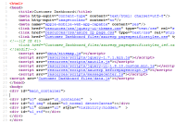
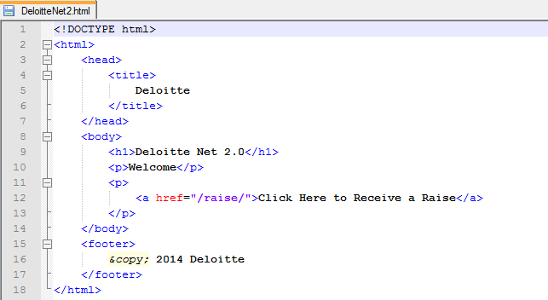
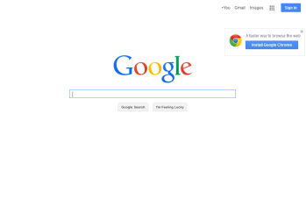
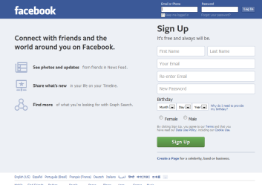


Web Development Introduction
Web Development
Web Application
Web development is a broad term used for describing work involved in created a website or a web application.
A web application is an application that uses an end-user’s web browser as a client to display dynamic information and content.
What benefits does the Web provide to clients?
Websites and web applications create opportunities to engage and connect with customers to gain a competitive advantage in the market
Web applications do not require a complex "roll out" procedure for deployment in large organizations – a compatible web browser is all that is needed.
Similarly, no upgrade procedures are required since all new features are implemented on the server and automatically delivered to the users.
Browser applications typically require little or no disk space on the client.
Web applications provide cross-platform compatibility in most cases (i.e., Windows, Mac, Linux, etc.) because they operate within a web browser window.
Notes:
Website generally refer to a collection of webpages and web applications. Websites point to a location on the internet where content is store – much like GPS coordinates point to a location on a map.
Running web applications allows more universal access as a standardized machine is not required to run an application for an enterprise/entity. This can reduce a client’s technlogy infrastructure requirements if the web application runs their needs.

Slide 5



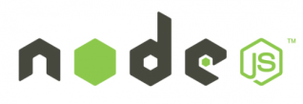


A Brief History of Web Development
Web Advancements
Past
Present
Future
CGI: Common Gateway Interface
One of the first server side interfaces, used for scripting
ASP: Active Server Pages
First Microsoft implementation of a server side language
J2EE
Java platform for running web applications
ASP.NET
Microsoft platform for running web applications
Django
Python framework for server side scripting
Ruby on Rails
Ruby framework for server side scripting
Node.js
A server side scripting language in JavaScript, eliminating the distinction between server-side and client-side.
Single Page Applications
A web application that fits on a single page aimed at providing a more fluid user experience.
Notes:
We will get into the specific technologies in the next section.

Slide 6
Web Application Examples
Web Applications have evolved to serve users in a variety of functions:
Online Services
eCommerce
Search Engines:
Google, Bing, Yahoo
Webmail:
Gmail, Yahoo Mail, HotMail
Alternatives to Desktop Software Applications:
Google Docs, Mint
B2B: GSA Advantage, DISA Direct
B2C: Dell, Amazon, Progressive
C2C: Ebay, Craigslist, Etsy
C2B: half.com, cars.com)
Web Applications
Media
Social Networking
Online News:
Huffington Post, CNN.com
Image/Video:
Flickr, Youtube, Photobucket
Blogs:
Blogger, WordPress, Tumblr
Social Networking:
Facebook, LinkedIn, Twitter, Classmates.com
Chat Sites:
chat-avenue, omgpop, Meebo
Notes:
Takeaway: Clients may have unique incentives to explore web applications as the best means for their business. Deloitte needs to be equipped with the skills and vision to help our clients realize their business needs.

Slide 7
Question
What are some benefits and advantages that the web provides to clients?
Websites and web applications create opportunities to gain a competitive advantage in the market
Web applications do not require a complex "roll out" procedure for deployment in large organizations
Browser applications typically require little or no disk space on the client.
It is not necessary to refresh or updated content on the web.
1
2
3
4
Notes:
Answer: 3

Slide 8
Agenda - Technologies
Web Development Overview
Technologies
Practices, Principles, and Frameworks
Web Development Methodologies
Vendor Choices

Slide 9
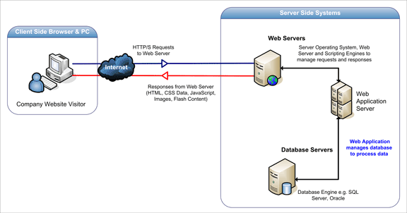
Front-End and Back-End Illustration
Front-End
Back-End
A Web Application is composed of Client Side Scripting, Server Side Scripting, and a Database:
Client Side Scripting is interpreted by the browser and displays content and information provided by the back-end
Server Side Scripting manages browser requests and creates, retrieves, updates, and/or deletes data from the database, and provides responses to the browser
The database stores the application data and is made accessible through server side scripting
Notes:
Talk about cloud?

Slide 10
Web Development Front-End (Client Side Scripting)
Client Side Scripting
Client Side Scripting represents code that is executed or interpreted on the end-user, or “client’s”, browsers.
The three primary examples of Client Side Scripting .
HTML (HyperText Markup Language)
HTML is the backbone of any website: it's not a programming language per se but rather a markup language using tags enclosed in angled brackets (e.g., <html>) to structure webpage content. Web browsers interpret the HTML tags and render them into visible web pages to users.
CSS (Cascading Style Sheet)
If HTML provides the structure of the webpage, CSS provides the style, look, and feel of the page. CSS is used to format the content of the page (e.g., font, color, position, and size). Additionally, CSS serves an important function in separating the style of the sections from the section content.
JavaScript
JavaScript is a computer programming language interpretable by web browsers. This allows scripts to interact with the user, control the browser, and alter the document content that is displayed. Since the mid-2000s, there has been a proliferation of server-side JavaScript implementations as well (e.g., Node.js)

Slide 11
Web Development Front-End (Client Side Scripting)
AJAX
AJAX (Asynchronous Javascript and XML): A technology used to create asynchronous web applications
Why do we want asynchronous applications?
Provides a better user experience allowing the user to interact with the web application without being affected by bandwidth issues
Enables Single-Page Applications (e.g. Facebook, Gmail) where the page is loaded once and never reloaded
The most commonly used way to dynamically load data onto a page without having to issue an HTTP POST or GET request
How is it implemented?
An XMLHttpRequest object is loaded
This object keeps an open connection with the server through long polling
Data is transferred back and forth as JSON, text, or HTML

Slide 12
Web Development Back-End (Server Side Scripting + Database)
Server Side Scripting
Server Side Scripting represents code that is executed or interpreted by the web server as opposed to the web browser.
It is intermediary between the audience and the audience’s access to proprietary data. This helps to protect/control access to data.
Because scripts are executed on the server side, the browser does not need to support the script at all
Examples:
ASP.NET (Microsoft's Web Application Framework - successor of ASP)
ColdFusion (Adobe's Web Application Framework)
Ruby on Rails (Ruby programming's Web Application Framework - free redistribution)
Python (general purpose high-level programming language and Server Side Scripting language - free redistribution)
Database Management System (DBMS)
Software system designed to allow the data definition, creation, retrieval, update, deletion, and administration of a database
Stores application data which is retrievable and editable by the server side scripts
Examples: MySQL, Oracle, IBM DB2, SQL Server
Notes:
Example of server side scripting: clicking “view account” on the web browser of a bank account send a request to the web server where Server Side Script executes commands to communicate with a data base, asking for the account information for a particular user.

Slide 13
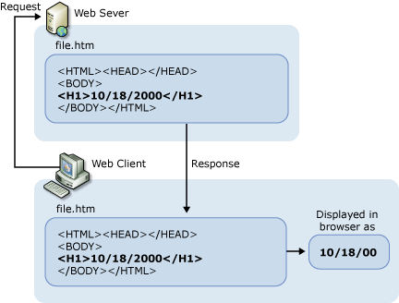
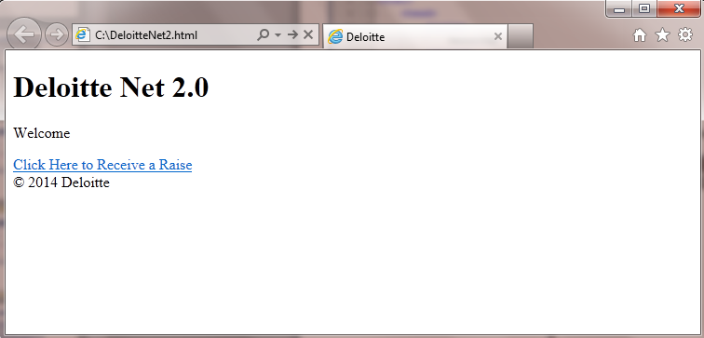
HTML Code Example
HTML provides the structure of the page content which the browser renders to a visible webpage:
1
2
3
4
5
1
2
3
4
5
Notes:
Participants should be encouraged to follow along and create a webpage on their own as we walk through the components of an HTML page

Slide 14
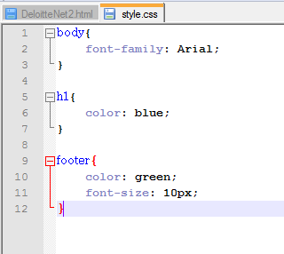
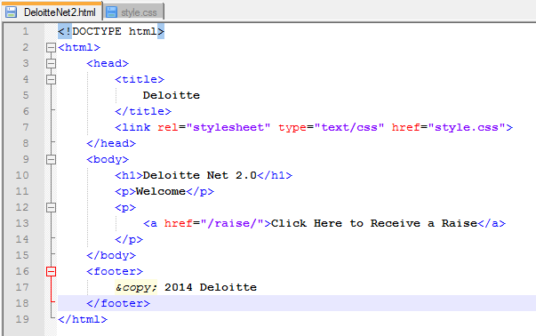
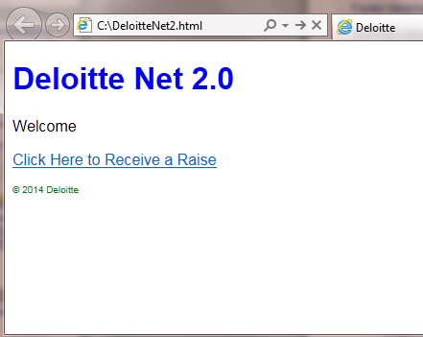
HTML & CSS Example
CSS allows the developer to change the style, positioning, and size of the HTML elements on the page. CSS creates cleaner code, facilitates faster development, and provides the developer with greater control over the page.
Notes:
Link tag is an empty element, it only contains attributes
This tag only goes in the head section but can appear multiple times (for javascript, fonts, etc.)
As a result the link tag does not have a “closing” tag

Slide 15
Question
Which of these is not a component of client side scripting?
HTML
CSS
JavaScript
Database
1
2
3
4
Notes:
Answer: 3

Slide 16
Agenda – Practices, Principles, and Frameworks
Web Development Overview
Technologies
Practices, Principles, and Frameworks
Web Development Methodologies
Vendor Choices

Slide 17
Web Development Practices and Principles – Coding Guidelines
Coding Guidelines
Coding guidelines provide a set of rules and standards used in developing a web site or web application.
These rules and standards apply to everything including coding logic, folder structure, file names, file organization, formatting and indentation, statements, classes and functions, and naming conventions.
Client Side
Server side
Some client side best practices and principles:
Keep Application logic separate from the HTML/CSS
Never use Inline Styles or Inline JavaScript
Keep HTML tag names lower case, i.e., <p> not <P>
Some server side best practices and principles:
Don’t Repeat Yourself (DRY)
Test as you write, handle errors elegantly
Reduce dependencies as much as possible
Important benefits of using Coding Guidelines:
Creates the a more productive development environment for multiple programmers to work
Provides ease of maintainability and version management
Delivers better readability and understanding of the source code
Ensures that other developers can understand and become familiar with the code in a short time

Slide 18
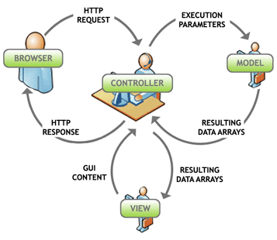
Web Development Design Pattern – Model-View-Controller (MVC)
The Model-View-Controller (MVC) design pattern is widely adopted architecture pattern for Web Applications in all major programming languages. MVC separates the modeling of the domain, the presentation, and the actions based on user input into three separate classes:
Model
Consists of application data, business rules, logic, and functions
Manages the Application data and state
Not concerned with UI or webpage presentation
Same model should be reusable, unchanged in different interfaces
View
Any output representation of information, such as a page, chart, or diagram
Present the Model to the user in an appropriate interface
Allows user to manipulate data
Easily reusable & configurable to display different data
Controller
Accepts input and converts it to commands for the model or view
Intermediary between Model & View
Can update the view when the model changes
Typically where the app logic lives
Notes:
Model-View-Controller (MVC) is a software architecture pattern. The model is the data, the view is the window on the screen, and the controller is the glue between the two taking the data and presenting that to the view .

Slide 19





Web Application Frameworks enables streamlined programming
Web Application Frameworks are sets of program libraries, components and tools organized in an architecture system allowing developers to build and maintain complex web application projects using a fast and efficient approach.
Web Application Frameworks are designed to streamline programming and promote code reuse by providing folder organization and structure, documentation, guidelines and libraries (reusable codes for common functions and classes).
Frameworks aims to alleviate the overhead associated with common activities performed in web development and help improve the quality and speed of development.
Web Application Frameworks help facilitate the rapid and streamlined development of dynamic websites and web applications.

Slide 20
Question
Which of these is NOT a benefit provided by web application frameworks?
Helps developers build and maintain complex web application projects
Streamlines programming by providing development libraries, components, and tools
Reduces the overhead associated with coding common activities performed
Developers don’t need to comment their code anymore
Promotes reusable code for common functions
1
2
3
4
5
Notes:
Answer: 5

Slide 21
Agenda – Web Development Methodologies
Web Development Overview
Technologies
Practices, Principles, and Frameworks
Web Development Methodologies
Vendor Choices

Slide 22



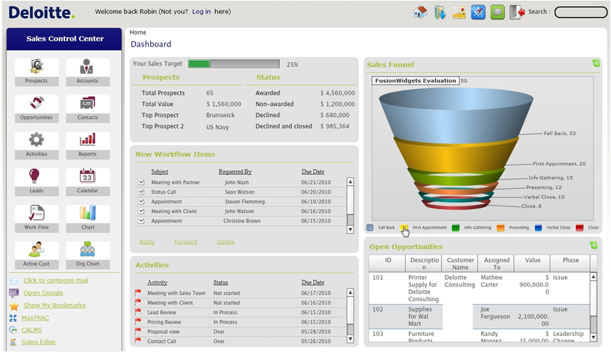
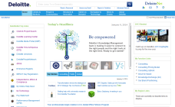


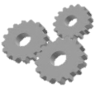
Development Methodologies – Traditional Waterfall Model
1. Requirements and Design
5. Maintenance and Support
Requirements for web site/application are gathered from users and design of solution is performed. Requirements and design must consider both front and back end aspects .
Monitoring and addressing issues that are discovered post-production to minimize loss-of-service
Design
Maintenance
2. Development
Develop
The web site/application is developed as per approved requirements and design.
4. Implementation
Deploy
Training users how to use/address issues of the web application as well as the actual deployment of the web application into production
Test
3. Testing
Thorough testing off the web application is to identify potential production issues and ensure a smooth as possible go live
Notes:
Talking points: example activities in each phase.

Slide 23
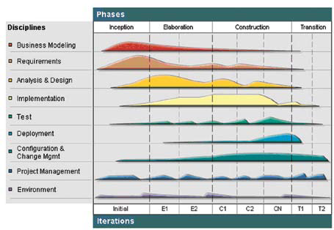
Development Methodologies – Rational Unified Process
With the Rational Unified Process solution, requirements planning, designing, implementing and testing of the applications are performed at each phase of the solution delivery lifecycle, enabling early and continuous risk detection.

Slide 24
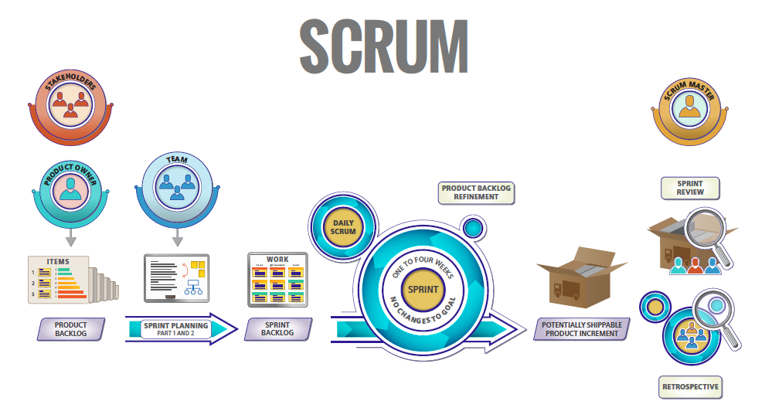
Development Methodologies – Agile
The Agile Methodology Rundown
A product owner creates a prioritized wish list called a product backlog.
During sprint planning, the team pulls a small chunk from the top of that wish list, a sprint backlog, and decides how to implement those pieces.
The team has a certain amount of time — a sprint (usually two to four weeks) — to complete its work, but it meets each day to assess its progress (daily Scrum).
Along the way, the ScrumMaster keeps the team focused on its goal.
At the end of the sprint, the work should be potentially shippable: ready to hand to a customer, put on a store shelf, or show to a stakeholder.
The sprint ends with a sprint review and retrospective.
As the next sprint begins, the team chooses another chunk of the product backlog and begins working again.

Slide 25
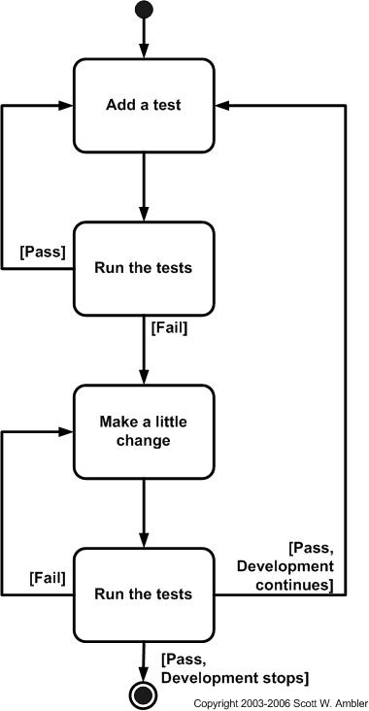
Development Methodologies – Test Driven Development
Test-driven development (TDD) is a development methodology which uses automated unit tests to drive the design of software and force decoupling of dependencies. The result of using this practice is a comprehensive suite of unit tests that can be run at any time to provide feedback that the software is still working.
Automated unit testing tools are available specifically for web applications – stay posted for the next slides!

Slide 26
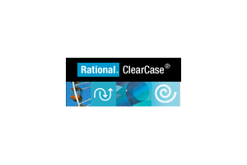





Development Resources
Source Control
Tracks revisions, central repository of code for all developers.
Leading solutions:
Continuous Build Tools
Allows for automated compiling and deployment of code

Slide 27
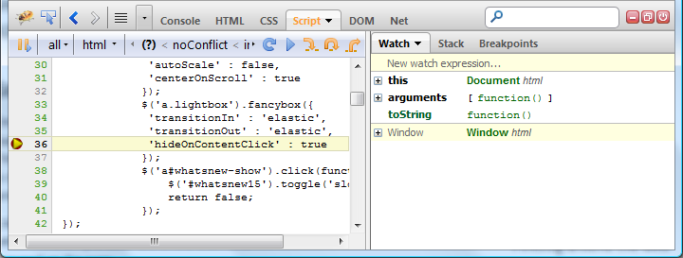
Development Resources
Debugging tools
Chrome Developer Tools, Firebug – Allows developers to see the JavaScript as it is running on a page
Firebug Example

Slide 28
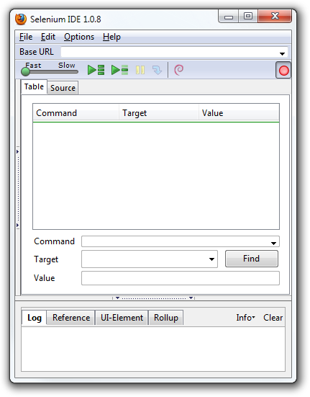
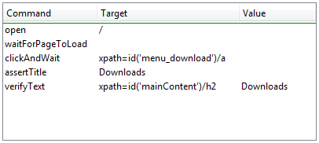

Development Resources
Web App Testing Tools
Selenium is one of the most used, and feature rich testing tools
Selenium IDE is a Firefox plugin which records and plays back user interactions with the browser. Use this to either create simple scripts or assist in exploratory testing

Slide 29
Question
Which of these is not considered an accepted Development Methodology?
Rational Unified Process
Agile
Test Driven Development
Brute Force Methodology
1
2
3
4
Notes:
Answer: 3

Slide 30
Agenda – Vendor Choices
Web Development Overview
Technologies
Practices, Principles, and Frameworks
Web Development Methodologies
Vendor Choices

Slide 31
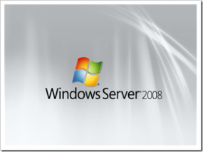

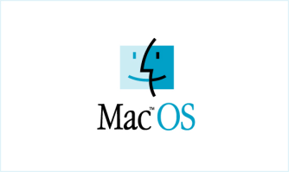



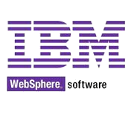








Vendor Choices – Different “Stacks”
The complexity of web development makes it incredibly difficult a vendor to serve as a “one-stop-shop” for all of the web application’s software component needs.
Instead, web applications are built on a solution stack, referring to a set of software components. In the case of a web application, the components required to build a complete stack are an operating system, web server, database, and scripting language.
Solution Stack Choices
Operating System
Web Server
Database
Scripting Language

Slide 32
Vendor Choices – “Stack” Options
A few examples of popular IT stacks:
 | LAMP | J2EE | WISA (.NET)
Vendor | Open Source | Java | Microsoft
Server Operating System (OS) | Linux | Linux | Windows Server
Web Server | Apache | IBM WebSphere | Internet Information Services (IIS)
Database Management System | MySQL, MongoDB, or MariaDB | Oracle, DB2 | SQL Server
Scripting Language | Python, PHP, Perl | Java | ASP.NET
Benefits | Open Source, Free | Presents most scalability and flexibility should the target deployment OS change | Variety of Support via Microsoft
Disadvantages | Collection of “middle-of-the-road” tools | High complexity and Resource use | Reliant on Microsoft technology/lack of portability
Bottom Line | Great for hobby/student development and small business development | Best to use if development can’t commit to a deployment just yet | Built and typically used for enterprise development
Note: Not an exhaustive list; other common IT stacks include but are not limited to: WAMP, Linux Python, MAMP, etc.

Slide 33
Vendor Choices - Database Options
There are numerous database options available with Oracle, IBM DB2, and Windows SQL Server considered the “big three”, and MySQL serving as a popular open source option:
 | Oracle | IBM DB2 | SQL Server | MySQL
Tool description | Widely used RDBMS | Common in IBM host environments | Microsoft relational DBMS | Widely used open source RDBMS
Maintainer | Oracle | IBM | Microsoft | Sun Microsystems (Acquired by Oracle Corporation)
License | Commercial | Commercial | Commercial | Open Source
Website | http://www.oracle.com/us/products/database/ | http://ibm.com/software/data/db2/ | http://www.microsoft.com/sqlserver/ | www.mysql.com
Server Operating Systems | AIX HP-UX Linux OS X Solaris Windows z/OS | Linux Unix Windows z/OS | Windows | FreeBSD Linux OS X Solaris Windows
Supported Languages | .Net, Java, PHP, Python, Ruby, Visual Basic | C, C#, C++, Cobol, Fortran, Java, Perl, PHP, Python, Ruby, Visual Basic | C, C#, C++, Clojure, Cobol, Eiffel, Erlang, Fortran, Groovy, Haskell, Java, JavaScript, Lisp, Objective C, OCaml, Perl, PHP, Python, R, Ruby, Scala, Tcl, Visual Basic | Ada, C, C#, C++, D, Eiffel, Erlang, Haskell, Java, Objective-C, OCaml, Perl, PHP, Python, Ruby, Scheme, Tcl
http://db-engines.com/en/system/DB2%3BMicrosoft+SQL+Server%3BMySQL%3BOracle

Slide 34
Question
Which of these is not a required component of a complete Web Development Solution Stack
Operating System
Web Server
Database
Web Application Framework
Scripting Language
1
2
3
4
5
Notes:
Answer: 2

Slide 35
Learning Objectives
Agenda
Objectives
Web Development Overview
Technologies
Practices, Principles, and Frameworks
Web Development Methodologies
Vendor Choices
Now that you have completed this course, you should be able to:
Provide an overview of Web Development and Web Applications
Describe the technology components necessary for Web Development
Apply Web Development best practices, design patterns, and frameworks
Describe different Web Development Methodologies
Compare and contrast Web Development “Stacks”
Notes:
Resources for developing this deck
http://www.comentum.com/guide-to-web-application-development.html
http://www.acunetix.com/websitesecurity/web-applications/
http://tutorials.csharp-online.net/index.php?title=Popular_Stacks
http://en.wikipedia.org/wiki/Web_application

Slide 36
Questions?
Thank You

